Slide 1
CSCI3170 Introduction to Database Systems
Tutorial 10 –Practice on Oracle
Xubin Zheng

Slide 2
Connect to Oracle DB via SQL Workbench

Slide 3
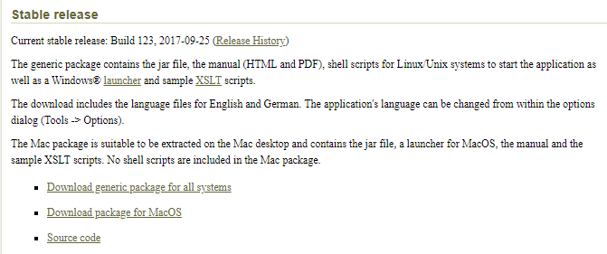
Connect to Oracle DB via SQL Workbench (1)
Firstly, download SQL Workbench package: http://www.sql-workbench.net/downloads.html
in case: https://www.java.com/en/download/

Slide 4

Connect to Oracle DB via SQL Workbench (2)
Unzip SQL Workbench package
Run “sqlworkbench.jar” (double click or open with java)

Slide 5
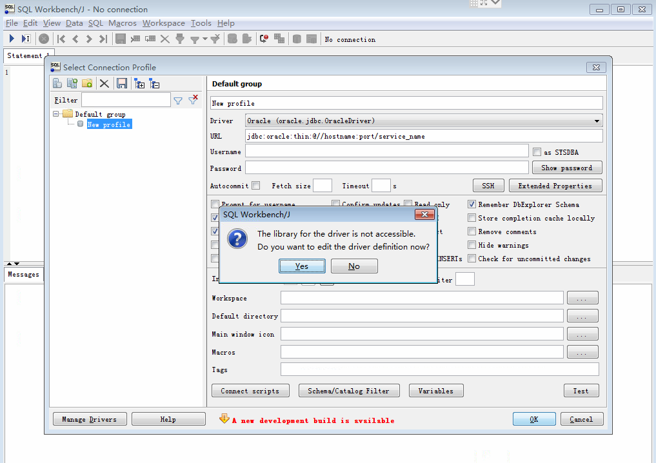
Connect to Oracle DB via SQL Workbench (3)
Choose the oracle driver

Slide 6
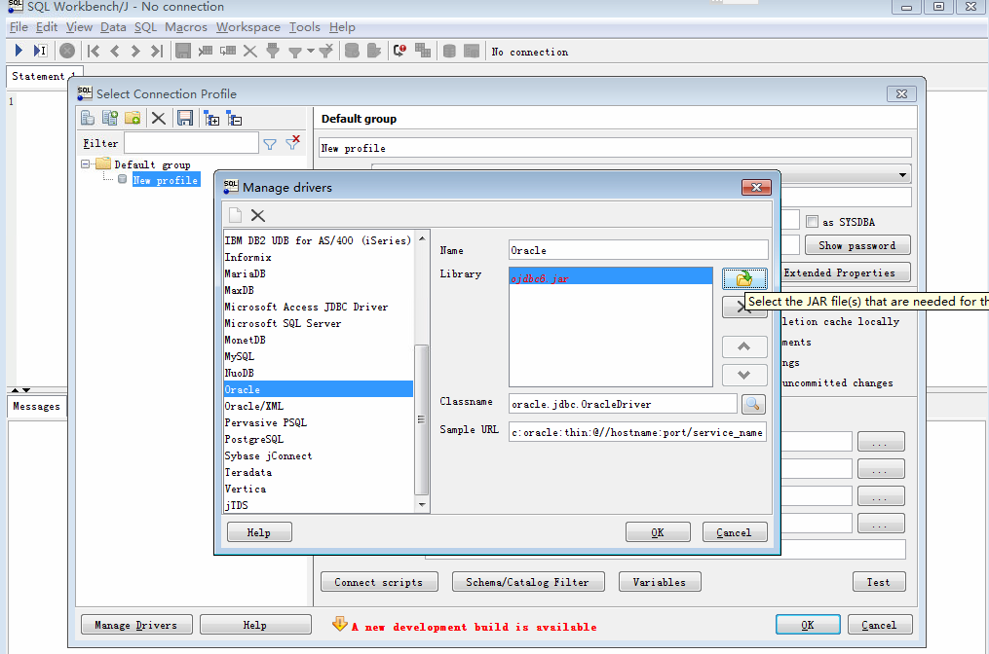
Connect to Oracle DB via SQL Workbench (4)
Select “ojdbc7.jar” as the driver.(You can find it in this tutorial package.)

Slide 7
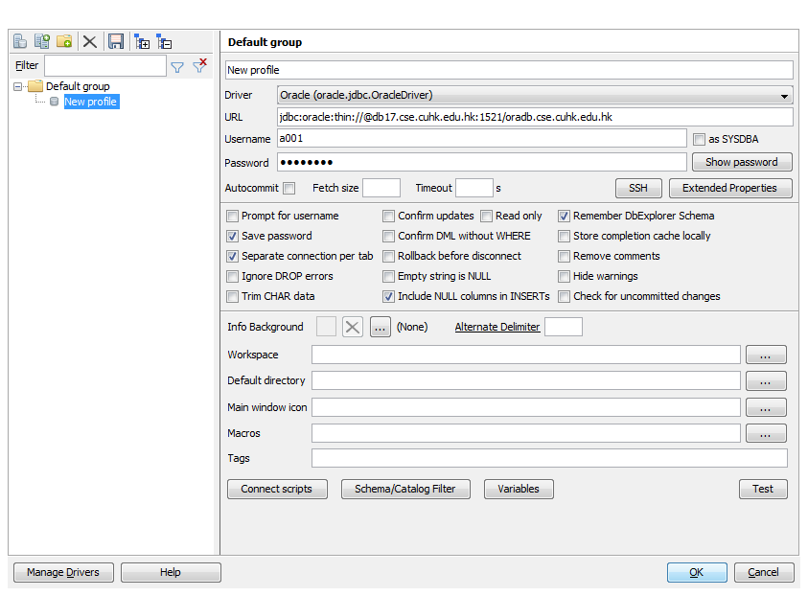
Connect to Oracle DB via SQL Workbench (5)
Click to do change on the drivers.

Slide 8
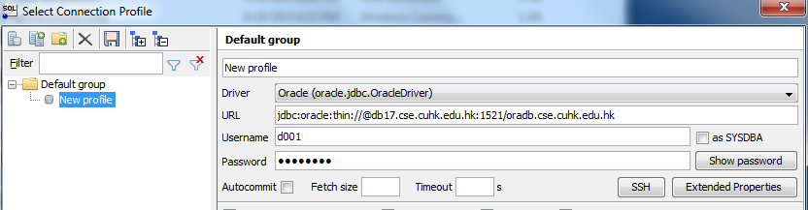
Connect to Oracle DB via SQL Workbench (6)
Type the URL jdbc:oracle:thin://@db18.cse.cuhk.edu.hk:1521/oradb.cse.cuhk.edu.hk, your Oracle Username and Password. Click OK to enter.

Slide 9
Another way to Connect to Oracle DB(1)
ssh to a linux host e.g. linux5 (or one of linux5 - linux16), login with your CSE unix account
after login successfully, type:
csh
source /opt1/oracle122/setup
sqlplus oracle_account@db18.cse.cuhk.edu.hk
Then input password: ******
Important!!! Assignment3 is based on that!

Slide 10
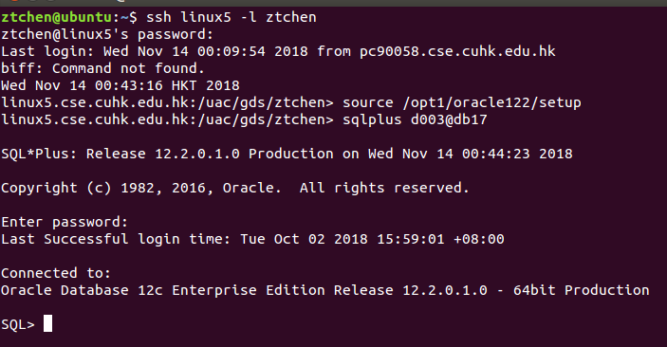
Another way to Connect to Oracle DB(2)
CSE Unix Account
Oracle Account

Slide 11
Begineer Practise on Oracle SQL

Slide 12
Dropping and Creating Table
(Pre-cautionary) dropping the table
Create Table
Note: When you want to type and run some new statements in SQL workbench, you need to delete the old ones in the window that you run before.
DROP TABLE S1;
Different to mysql:
DROP TABLE IF EXISTS S1;
CREATE TABLE S1(
sid integer primary key,
name varchar(30) not null,
year integer,
age integer);

Slide 13
Inserting Rows
Inserting values one row by one row
INSERT INTO S1 VALUES (1,'Peter',3,22);
INSERT INTO S1 VALUES (2,'John',2,20);
INSERT INTO S1 VALUES (3,'Mary',4,29);
SELECT * FROM S1;

Slide 14
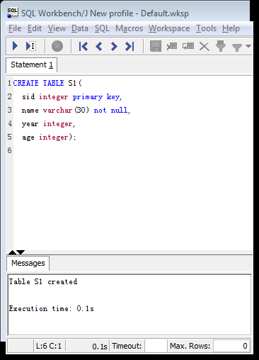
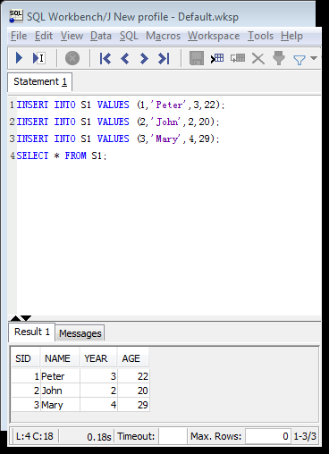
Click the icon to execute
Clean the old statements
Before starting a new one.

Slide 15
Updating Rows
Update one row and view the results
Another form of update
UPDATE S1 SET age = 20 WHERE sid = 3;
SELECT * FROM S1;
UPDATE S1 SET age = age + 1;
SELECT * FROM S1;

Slide 16
Alter Table And View Schema
Alter the table
Show the table schema (Oracle-specific syntax)
Note: before altering the table, you need to clean the data you insert before (suggested command: “DELETE S1;”) or drop the old table and create a new empty one.
ALTER TABLE S1 MODIFY (age DATE, sid varchar(20));
DESCRIBE S1;
Different to mysql:
MODIFY age DATE, MODIFY sid varchar(20)

Slide 17
Print, Count and Delete Rows
Printing the entire table
Count the number of rows in the table
Delete all data from the table
SELECT * FROM S1;
SELECT COUNT(*) FROM S1;
DELETE FROM S1;

Slide 18
Immediate Practise on Oracle SQL with Data Files

Slide 19
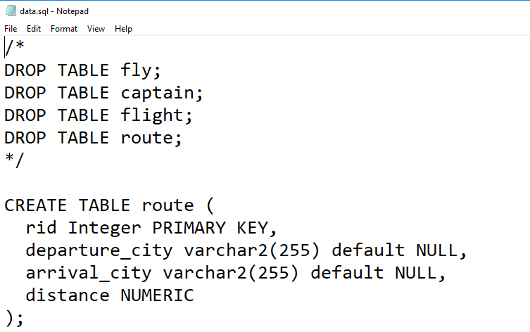
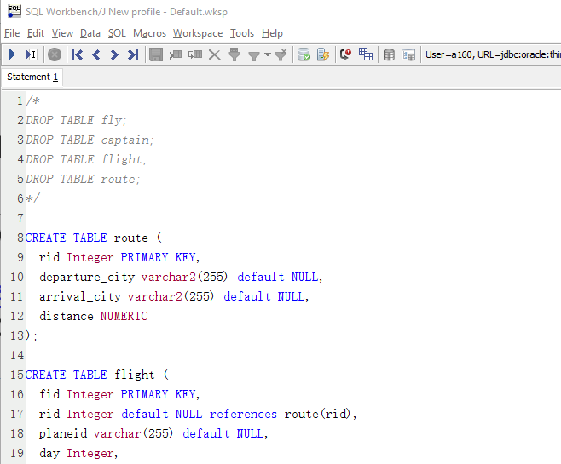
Importing SQL Data Files
You can get the SQL file “data.sql” with this tutorial slides.
Open the SQL file and copy the content into the window and run it.
When you want to create a new table, you need to drop the table having the same name first.

Slide 20
Simple SELECT statements
SELECT * FROM captain;
SELECT * FROM captain WHERE cid < 5;
SELECT * FROM captain WHERE cid < 5 AND experiencehour > 3000;
SELECT cname FROM captain WHERE cid < 5 AND experiencehour > 3000;
SELECT cname AS name FROM captain WHERE experiencehour < 3000;

Slide 21
SELECT with ORDERing
SELECT * FROM captain ORDER BY cid ASC;
SELECT * FROM captain ORDER BY cid DESC;
SELECT * FROM route ORDER BY arrival_city ASC, departure_city ASC;

Slide 22
SELECT with Joining
Cartesian Product
Emulating Natural Join
SELECT COUNT(*) FROM captain, fly;
SELECT COUNT(*) FROM captain, fly WHERE captain.cid = fly.cid;
SELECT COUNT(*) FROM captain C, fly F WHERE C.cid = F.cid;

Slide 23
Aggregate Function and DISTINCT
Minimum, maximum, sum and average…
Distinct Keyword
SELECT MAX(distance) FROM route;
SELECT SUM(experiencehour), AVG(experiencehour) FROM captain;
SELECT DISTINCT cid FROM fly;
SELECT COUNT(DISTINCT cid) FROM fly;

Slide 24
GROUP BY and HAVING
SELECT cid, count(fid) FROM fly GROUP BY cid;
SELECT cid, count(fid) FROM fly GROUP BY cid ORDER BY count(fid);
SELECT cid, count(fid) FROM fly GROUP BY cid HAVING count(fid) > 3;

Slide 25
VIEW
Use view to store results of queries that are used later:
Creating a View (if exist, replace it)
Dropping a VIEW
CREATE OR REPLACE VIEW temp1 AS (SELECT DISTINCT cid FROM fly);
DROP VIEW temp1;

Slide 26
Additional Practise on Oracle SQL

Slide 27
Example with SQL Date Data-type
CREATE TABLE S1 (A INTEGER, B DATE);
INSERT INTO S1 VALUES (1, to_date('01/01/2016', 'dd/mm/yyyy'));
INSERT INTO S1 VALUES (2, to_date('01/07/2016', 'dd/mm/yyyy'));
SELECT * FROM S1;
Different to mysql:
‘%d/ %m/ %Y’;
SELECT MAX(B)-MIN(B) FROM S1;
SELECT * FROM S1 WHERE B > to_date('01/06/2016', 'dd/mm/yyyy');

